Slide 1



Data Analysis on Boston Crime Record Prepared By Mariem Ahmed Elhoseny Mariem Hossam Mahmoud Omar Mohamed Elemary Rokaya Mahmoud Shama Weaam Ahmed Abdelmoniem
Track / Data Analyst specialist
Supervision of
Abdallah Kamal

Slide 2
Acknowlegment
On my own behalf and on behalf of my team & the whole group
We would like to express our sincere gratitude to the Ministry of Communications and Information Technology (MCIT) for launching the Digital Egypt Pioneers Initiative (DEPI), and specifically for the Data Analyst Specialist track.
We also extend our appreciation to Next Academy for their invaluable collaboration in this endeavor. A special thank goes for Abdullah Kamal for his dedication and expertise as instructor, guiding us through this vital program.
Together, we are equipped as data analysts with the tools needed to secure us freelancing employment opportunities in the data analytics field. Thanks to everyone involved for this commitment to fostering our skills and shaping a brighter future for us.

Slide 3
Agenda
01.
02.
03.
04.
Project Overview
Data Analysis
Data Visualization
Conclusion

Slide 4
01.
Project Overview

Slide 5
Project Overview
Objective
Explore, analyze, and visualize crime data from Boston to identify patterns, trends, and correlations that can inform law enforcement decision-making, support effective crime prevention measures and improve community safety.
Tools
By leveraging data analytics tools such as Excel, Python, and Tableau, the project aims to develop comprehensive insights.
Problem Statement
Many communities struggle to effectively prevent crime. However, police and law agencies face challenges in understanding the complex patterns and trends of crime instances. This lack of evidence-based decision-making hinders proactive crime prevention efforts. Our aim is to fill this gap by providing comprehensive insights that fulfill the demands of a safe society and eliminate crime incidents.
Expected Outcomes
Descriptive Insights, Predictive Insights, Operational Insights, Visual Outputs
Data Collection
Dataset from official Boston government records, which included comprehensive details on crime reports filed between 2015 and 2018.

Slide 6
02.
Data Analysis

Slide 7
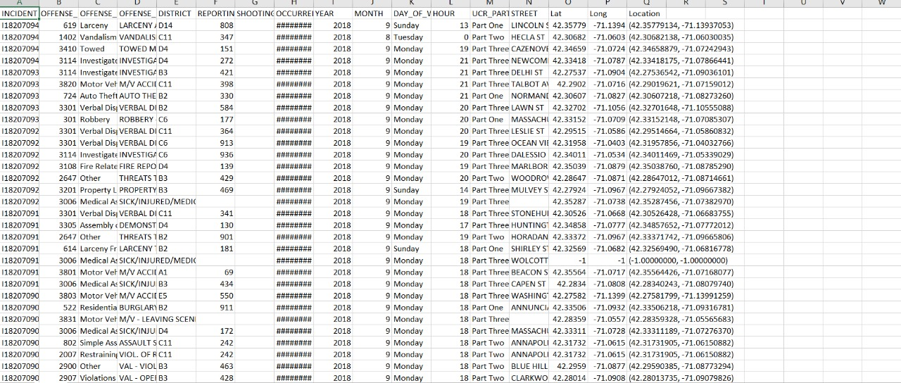
Data Analysis ( Python )

Slide 8

Data Analysis ( Python )

Slide 9
Data Analysis ( Python )

Slide 10
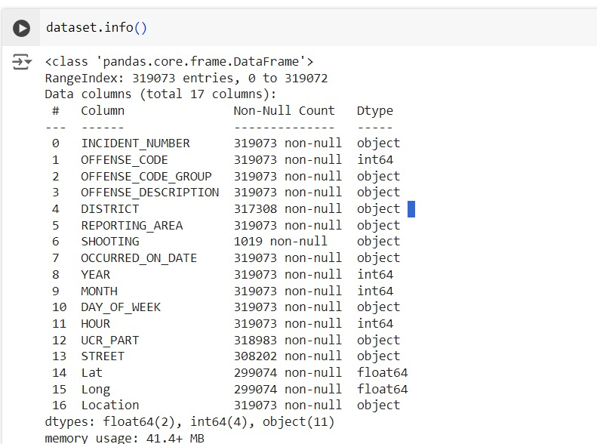
Data Analysis ( Python )

Slide 11
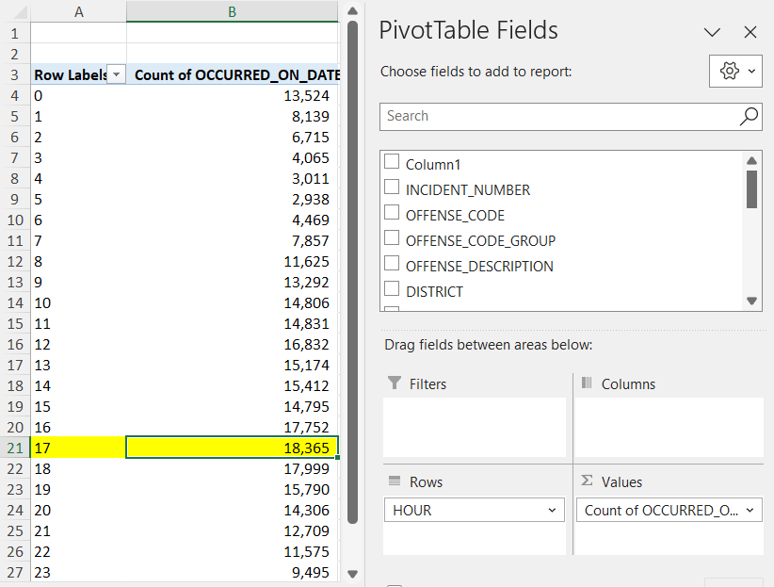
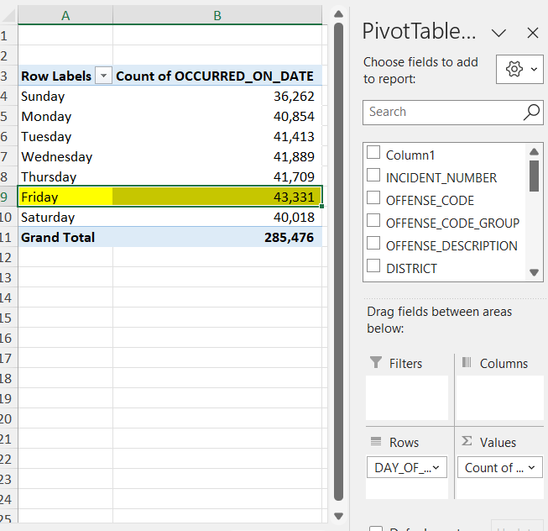
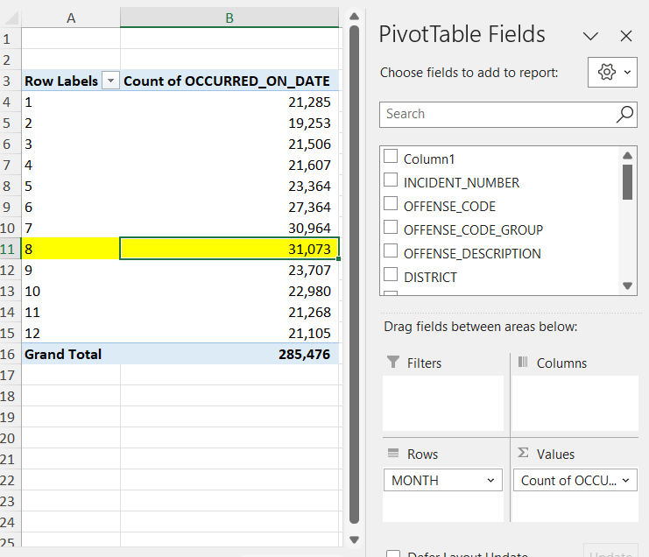
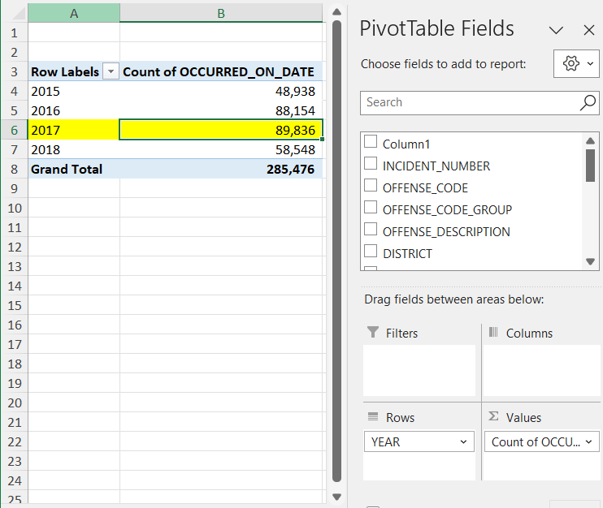
Data Analysis ( Excel - Pivot Tables )
Hour
Day
Month
Year

Slide 12
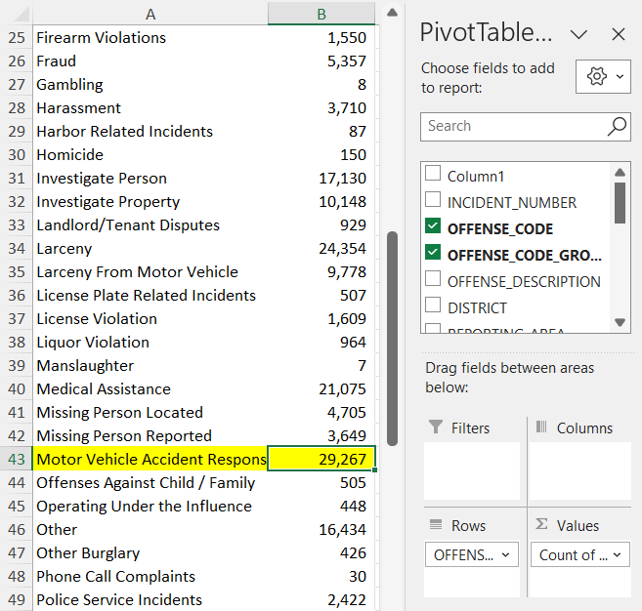
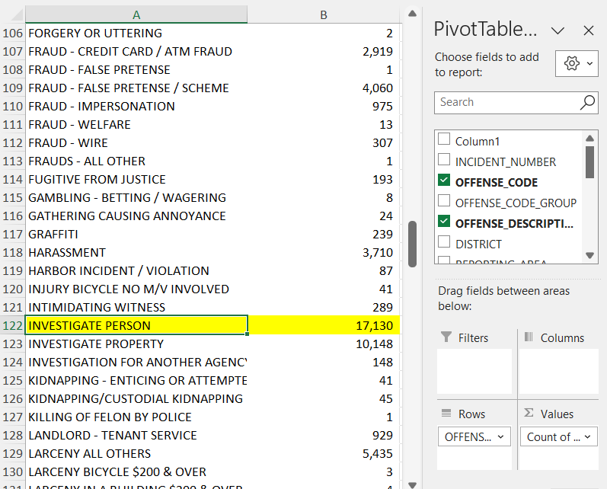
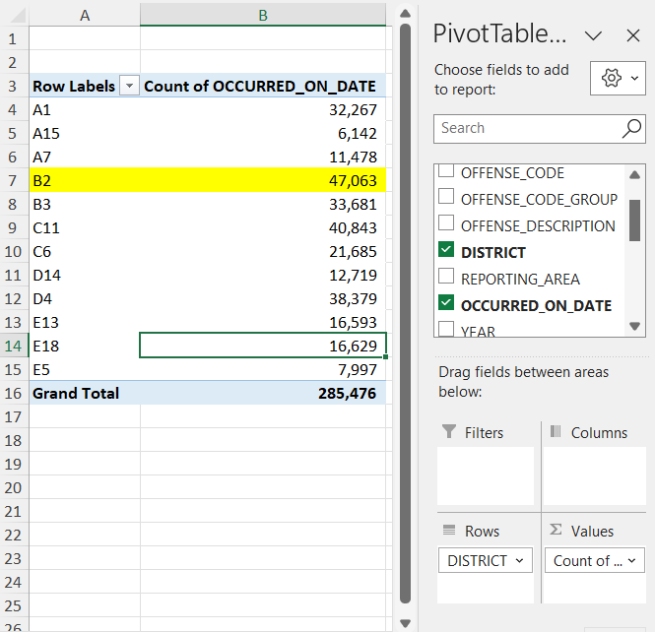
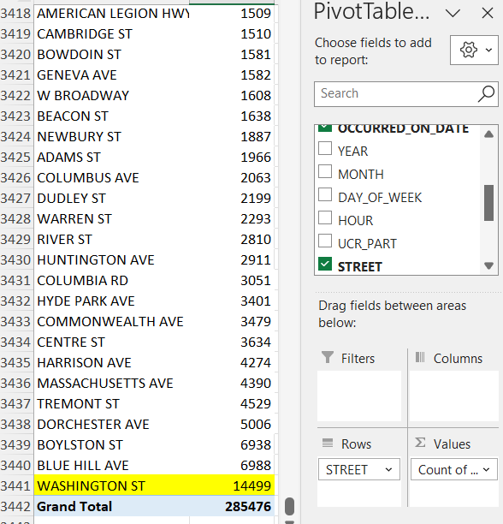
Data Analysis ( Excel - Pivot Tables )
Offense Code
Offense Description
District
Street

Slide 13
03.
Data Visualization

Slide 14
The following dashboard answer these questions and even more:
What are the most common crime types in Boston?
The dashboard can provide a breakdown of the top 10 crimes, likely showing categories like property crimes, violent crimes, and others.
2. How have crime rates changed over time in Boston?
The "Crimes Over Years" chart would visualize trends in crime occurrences over a specific period, allowing users to identify increases or decreases in crime rates.
3. Are there specific areas or neighborhoods in Boston with higher crime?

Slide 15
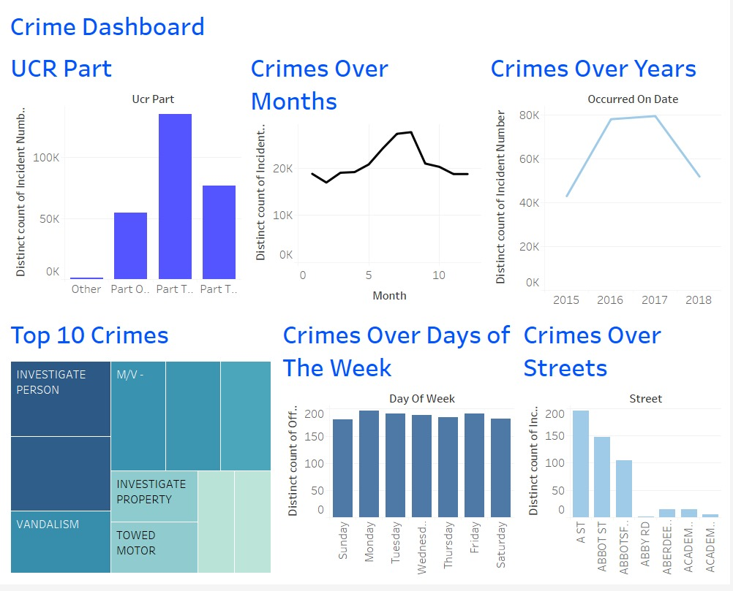
Figure 1 ( Crime Dashboard )

Slide 16
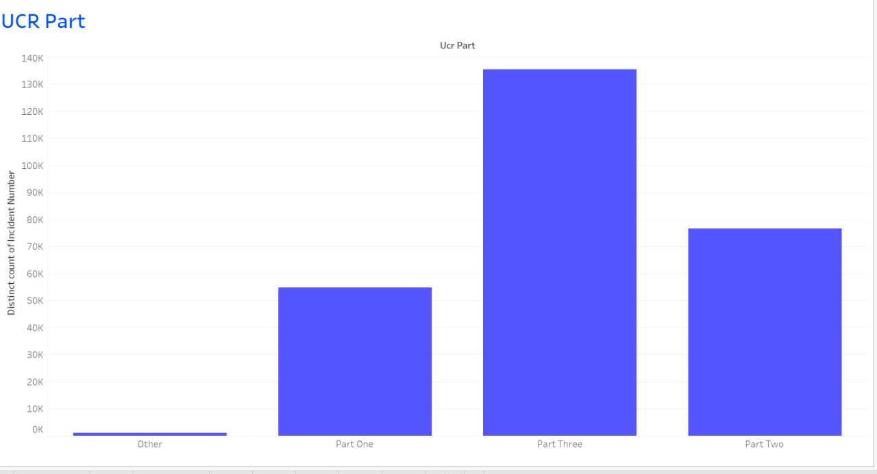
Figure 2 ( UCR )

Slide 17
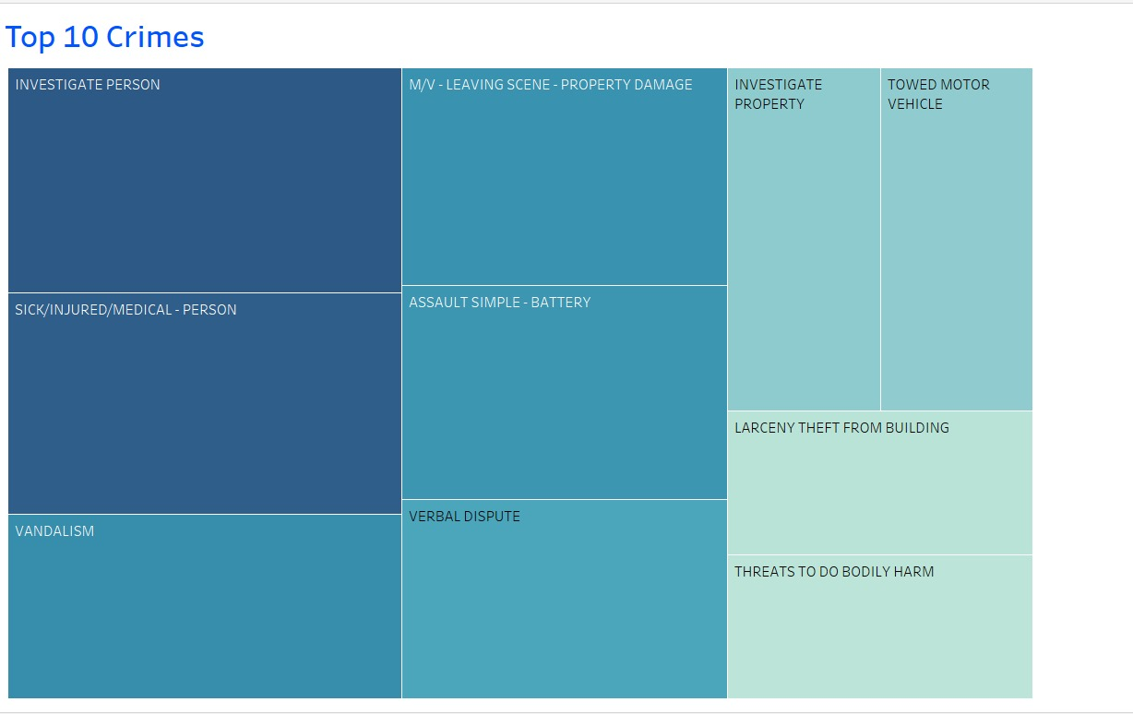
Figure 3 ( Top 10 Crimes )

Slide 18
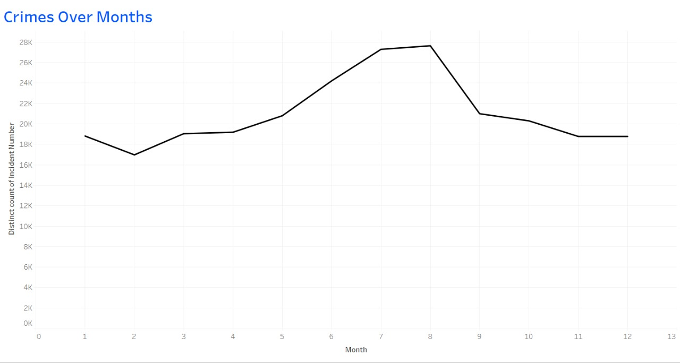
Figure 4 ( Crimes Over Months )

Slide 19
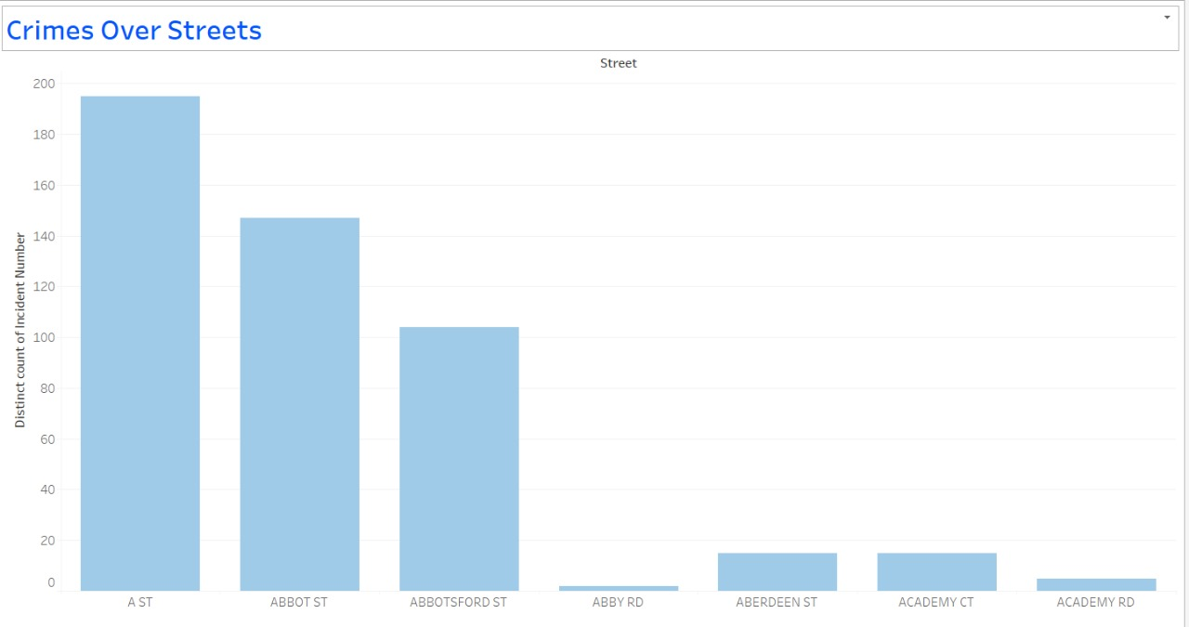
Figure 5 ( Crimes Over Street )

Slide 20
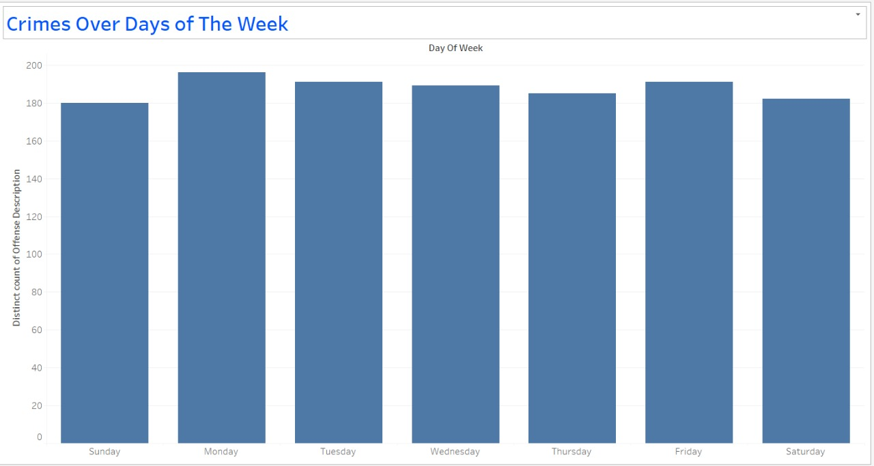
Figure 6 ( Crimes Over Days of the Week)

Slide 21
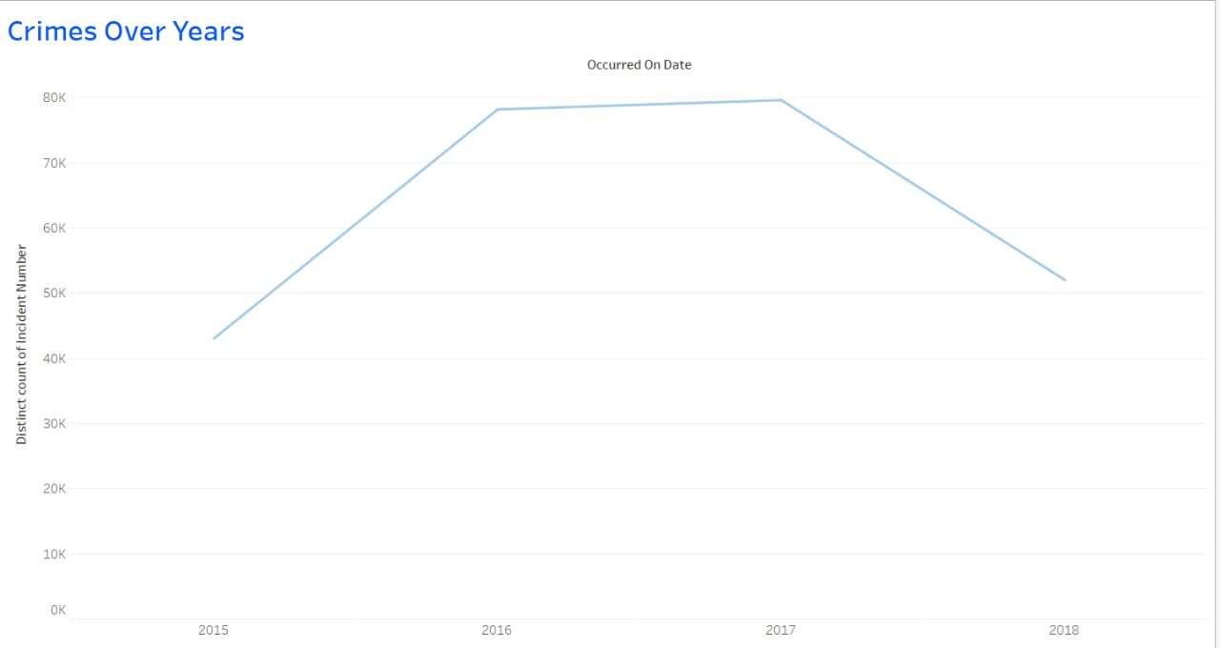
Figure 7 ( Crimes Over Years )

Slide 22
04.
Conclusion

Slide 23
Conclusion
This project showcases the importance of data-driven approaches in addressing the challenges of crime prevention and community safety.
By analyzing Boston's crime data, we have identified crucial patterns and trends that can inform police strategies, optimize resource deployment, and improve public safety outcomes.
The insights generated through this project are valuable for both law enforcement agencies and policymakers in Boston, as they provide evidence-based recommendations for reducing crime rates and enhancing the quality of life for residents.

Slide 24
Recommendations
Place | Increase the number of police car patrols on Washington Street in B2
Time | Increase number of police shifts from 1 PM to 6 PM
Seasonal Trend | Increase number of police shifts .A peak in crimes during warmer months (August)
Predictive models can be developed to forecast future crime occurrences, assisting in proactive intervention planning.

Slide 25
Thanks!

